Slide 1
Jhansi V.K
Final Project
3/21/2024 Annual Review

Slide 2
PROJECT TITLE
Text generation using GANs
3/21/2024 Annual Review

Slide 3


AGENDA
The agenda is to discuss the following points:
Introduction
Problem Statement
Problem Overview
End Users
Modeling Techniques
Results and Evaluation
3/21/2024 Annual Review

Slide 4

PROBLEM STATEMENT
Automating text generation to produce contextually relevant and coherent outputs, facilitating diverse applications across domains like creative writing, chatbots, and content generation.
3/21/2024 Annual Review

Slide 5

PROJECT OVERVIEW
This project aims to develop a text generation system leveraging automated techniques to produce contextually relevant and coherent text. By utilizing methods such as Markov chains or advanced AI models like GPT, the system will generate text that mimics the style and structure of the input data. The generated text can find applications in various domains such as creative writing, chatbots, and content generation, enhancing productivity and creativity across different field .
3/21/2024 Annual Review

Slide 6

WHO ARE THE END USERS?
The text generation system caters to a diverse array of users across various industries and domains. It aids writers and content creators in overcoming writer's block and generating content for articles and stories. Chatbot developers enhance conversational interfaces, marketers boost content strategies, and educators utilize it for educational purposes. Researchers benefit from experimentation and advancement in natural language processing techniques. Overall, the system serves as a valuable tool, enhancing productivity, creativity, and communication for all its users.
3/21/2024 Annual Review

Slide 7

YOUR SOLUTION AND ITS VALUE PROPOSITION
The text generation system offers automated generation of contextually relevant text, providing solutions for writer's block, enhancing chatbot interactions, boosting marketing strategies, facilitating educational content creation, and advancing research in natural language processing. Its value proposition lies in empowering users across industries with a versatile tool that enhances productivity, creativity, and communication.
3/21/2024 Annual Review

Slide 8

THE WOW IN YOUR SOLUTION
Its seamless use of advanced technology to generate high-quality text effortlessly, catering to diverse user needs across industries, from overcoming writer's block to enhancing chatbot interactions, boosting marketing strategies, facilitating education, and advancing research.
3/21/2024 Annual Review

Slide 9
MODELLING
Teams cam add wireframes
To implement the text generation system, we can use modeling techniques such as Markov chains, recurrent neural networks (RNNs), generative adversarial networks (GANs), or transformer models like GPT. Each technique offers different capabilities and complexities, allowing us to tailor the solution based on the specific requirements and constraints of the project.
3/21/2024 Annual Review

Slide 10
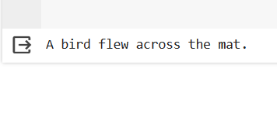

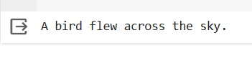
RESULTS
Text generation utilizes various techniques like Markov chains, RNNs, GANs, or transformer models (e.g., GPT) to produce diverse outputs, catering to different needs and constraints.
A text is generated from the input provided to the model, resulting from four different sentences .
Demo Link
3/21/2024 Annual Review

